Slide 1


WAVELET TRANSFORM
Supervisor: Dr. Lý Quốc Ngọc
Group 9: Hồ Quang Minh - 1211042
Đỗ Đặng Minh - 1311015
Huỳnh Công Toàn - 1311026
Dương Xuân Long - 1311048
Hồ Văn Tấn - 1311058
Notes:
Version: 1.1.1
Last update: Ocotober 19, 2014

Slide 2
OUTLINE
Fourier Transform
Wavelet Transform
Multiresolution Analysis
Continuous Wavelet Transform
Discreet Wavelet Transform
Fast Wavelet Transform
Lifting Scheme
Wavelet Packet
Wavelet Transform Application
JPEG 2000
EZW Algorithm
Demo

Slide 3
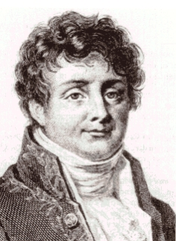
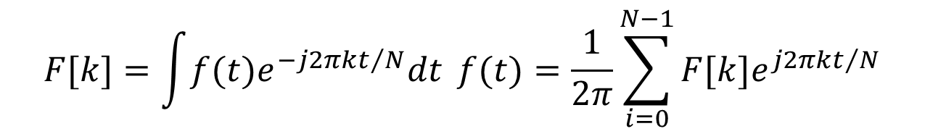
FOURIER TRANSFORM
Frequency domain: Joseph Fourier (1807).
Cannot provide simultaneously time and frequency information.
$$F[k]=\int{f(t)e^{−j2πkt/N}dt} f(t)=\frac{1}{2π}\sum_{i=0}^{N−1}{F[k]e^{j2πkt/N}}$$
Notes:
Transform: A mathematical operation that takes a function or sequence and maps it into another one.
The transform of a function may give additional/hidden information about the original function, which may not be available/obvious otherwise.
The transform of an equation may be easier to solve than the original equation.
The transform of a function/sequence may require less storage, hence provide data compression/reduction.
An operation may be easier to apply on the transformed function, rather than the original function (recall convolution).

Slide 4


FOURIER TRANSFORM
Recall that FT uses complex exponentials (sinusoids) as building blocks.
For each frequency of complex exponential, the sinusoid at that frequency is compared to the signal.
If the signal consists of that frequency, the correlation is high → large FT coefficients.
If the signal does not have any spectral component at a frequency, the correlation at that frequency is low / zero, → small / zero FT coefficient.
$$e^{jωt}=cos\left(ωt\right)+jsin\left(ωt\right)$$
$$F\left(ω\right)=\int{f\left(t\right)e^{−jωt}dt}$$
$$f(t)=\frac{1}{2π}\int{F(ω)e^{jωt}dω}$$

Slide 5
Stationary and Non-stationary Signals
FT identifies all spectral components present in the signal, however it does not provide any information regarding the temporal (time) localization of these components.
Stationary signals consist of spectral components that do not change in time
all spectral components exist at all times
no need to know any time information
FT works well for stationary signals
However, non-stationary signals consists of time varying spectral components
How do we find out which spectral component appears when?
FT only provides what spectral components exist, not where in time they are located.
Need some other ways to determine time localization of spectral components.
Notes:
Stationary signal: tín hiệu dừng

Slide 6
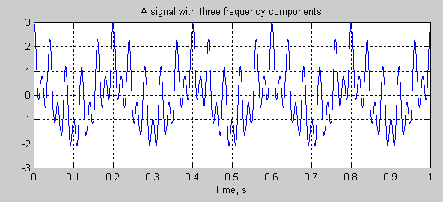
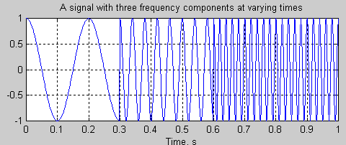
Stationary and Non-stationary Signals
Stationary signals’ spectral characteristics do not change with time
Non-stationary signals have time varying spectra
Concatenation

Slide 7
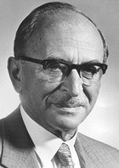

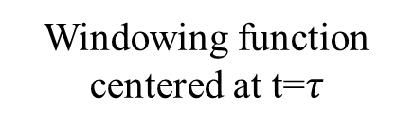

SHORT-TIME FOURIER TRANSFORM
Time-Frequency analysis:
STFT (Dennis Gabor 1946).
$$STFT\left\{x\left(t\right)\right\}\left\{τ,ω\right\}≡X\left(τ,ω\right)=\int_{−∞}^{∞}{x(t)ω\left(t−τ\right)e^{−jωt}dt}$$
Time
parameter
Frequency
parameter
Signal to
be analyzed
FT Kernel
(basis function)
STFT of signal x(t):
Computed for each
window centered at t=$τ$
Windowing
function
Windowing function
centered at t=$τ$
Notes:
Choose a window function of finite length
Put the window on top of the signal at t=0
Truncate the signal using this window
Compute the FT of the truncated signal, save.
Slide the window to the right by a small amount
Go to step 3, until window reaches the end of the signal
For each time location where the window is centered, we obtain a different FT.
Hence, each FT provides the spectral information of a separate time-slice of the signal, providing simultaneous time and frequency information.

Slide 8
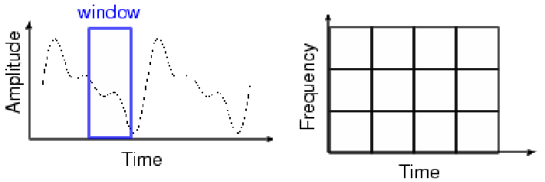
SHORT-TIME FOURIER TRANSFORM
Wide analysis window ➔ poor time resolution, good frequency resolution.
Narrow analysis window ➔ good time resolution, poor frequency resolution.
Once the window is chosen, the resolution is set for both time and frequency.
Notes:
Choose a window function of finite length
Put the window on top of the signal at t=0
Truncate the signal using this window
Compute the FT of the truncated signal, save.
Slide the window to the right by a small amount
Go to step 3, until window reaches the end of the signal
For each time location where the window is centered, we obtain a different FT
Hence, each FT provides the spectral information of a separate time-slice of the signal, providing simultaneous time and frequency information

Slide 9
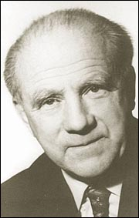
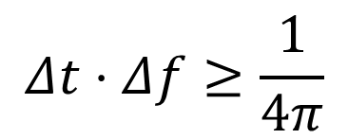
Heisenberg Uncertainty Principle
$$Δt⋅Δf≥\frac{1}{4π}$$
Time resolution: How well two spikes in time can be separated from each other in the transform domain
Frequency resolution: How well two spectral components can be separated from each other in the transform domain
Both time and frequency resolutions cannot be arbitrarily high!!! ➔ ➔We cannot precisely know at what time instance a frequency component is located. We can only know what interval of frequencies are present in which time intervals

Slide 10
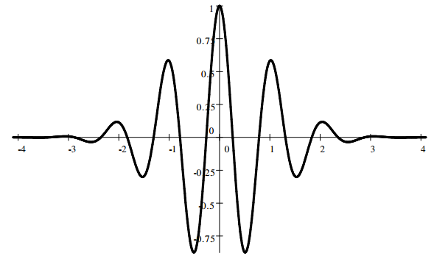
WAVELET TRANSFORM
Wavelets are mathematical functions.
Wavelet Transform: Decomposition of a signal into constituent parts.
Principles of wavelet transform:
Split up the signal into a bunch of signals.
Representing the same signal, but all corresponding to different frequency bands.
Providing what frequency bands exists at what time intervals.
Notes:
Fourier series: harmonic sinusoids; single integer index
Fourier transform (FT): nonharmonic sinusoids; single real index
Walsh decomposition: “harmonic” square waves; single integer index
Karhunen-Loeve decomp: eigenfunctions of covariance; single real index
Short-Time FT (STFT): windowed, nonharmonic sinusoids; double index
Wavelet Transform: time-compacted waves; double index

Slide 11
WAVELET TRANSFORM
Overcomes the preset resolution problem of the STFT by using a variable length window.
Analysis windows of different lengths are used for different frequencies:
Analysis of high frequenci.es➔ Use narrower windows for better time resolution.
Analysis of low frequencies ➔ Use wider windows for better frequency resolution.
This works well, if the signal to be analyzed mainly consists of slowly varying characteristics with occasional short high frequency bursts.
Heisenberg principle still holds!!!
The function used to window the signal is called the wavelet.

Slide 12
WAVELET TRANSFORM
Wavelet transform also provides time-frequency view
Decomposes signal in terms of duration-limited, band-pass components
high-frequency components are short-duration, wide-band
low-frequency components are longer-duration, narrow-band
Can provide combo of good time-frequency localization and orthogonality
the STFT can’t do this
More precisely, wavelets give time-scale viewpoint
this is connected to the multi-resolution viewpoint of wavelets

Slide 13
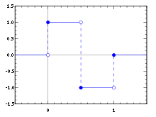
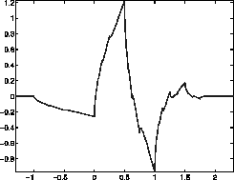
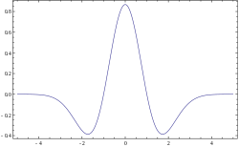
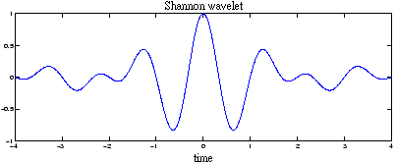
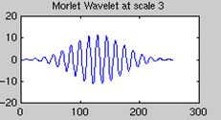
TYPES OF WAVELET
Daubechies
Haar
Mexican hat
Shannon
Morlet

Slide 14

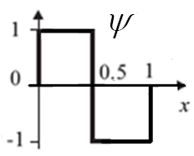
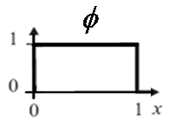
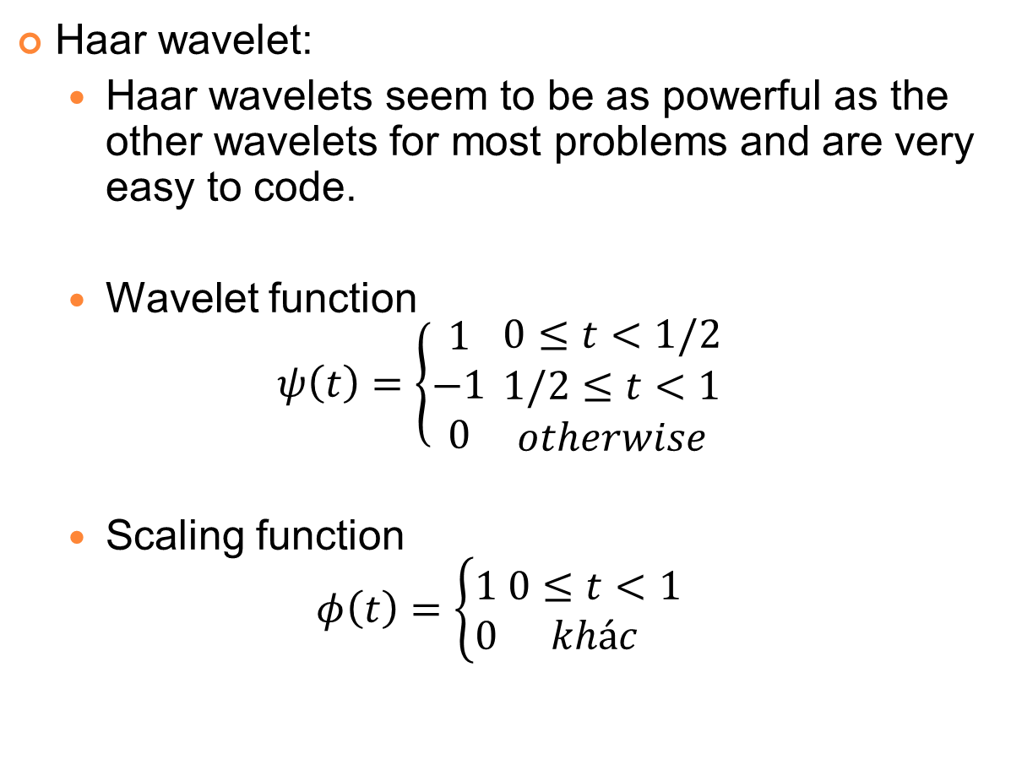
TYPES OF WAVELET
Haar wavelet:
Haar wavelets seem to be as powerful as the other wavelets for most problems and are very easy to code.
Wavelet function
$$ψ\left(t\right)=\left\{\begin{aligned}1 \\ −1 \\ 0\end{aligned} \right.\begin{matrix}0≤t<1/2 \\ 1/2≤t<1 \\ otherwise\end{matrix}$$
Scaling function
$$φ\left(t\right)=\left\{\begin{aligned}1 \\ 0\end{aligned} \begin{matrix}0≤t<1 \\ khác\end{matrix}\right.$$

Slide 15
Image Pyramids
Compute a reduced-resolution approximation of the input image
Filtering (Averaging, Gaussian)
Down-sampling
Up-sample the output of the previous by a factor 2
Compute the difference between the prediction of step 2 and the input to Step 1.
Notes:
Upsampling (or interpolation) is done by zero inserting between every two coefficients.

Slide 16
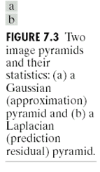
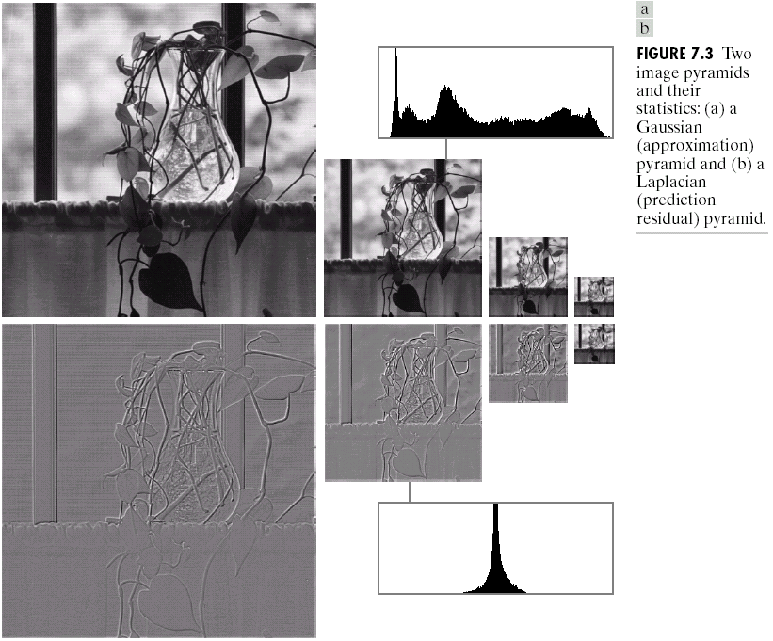
Image Pyramids

Slide 17
Subband Coding
If we regard the wavelet transform as a filter bank, then we can consider wavelet transforming a signal as passing the signal through this filter bank.
The outputs of the different filter stages are the wavelet- and scaling function transform coefficients.
In general we will refer to this kind of analysis as a multiresolution.
That is called subband coding.

Slide 18
Subband Coding
Splitting the signal spectrum with an iterated filter bank.
Summarizing, if we implement the wavelet transform as an iterated filter bank, we do not have to specify the wavelets explicitly! This is a remarkable result.
8B
f
LP
4B
HP
4B
f
LP
HP
4B
f
2B
2B
LP
HP
2B
4B
f
B
B

Slide 19
MULTIRESOLUTION ANALYSIS
In Multi-resolution Analysis (MRA), a Scaling Function is used to create a series of approximations of a function or image, each differing by a factor 2 from its nearest neighboring approximations. Additional functions, called Wavelet, are used to encode the difference in information between adjacent approximation.

Slide 20
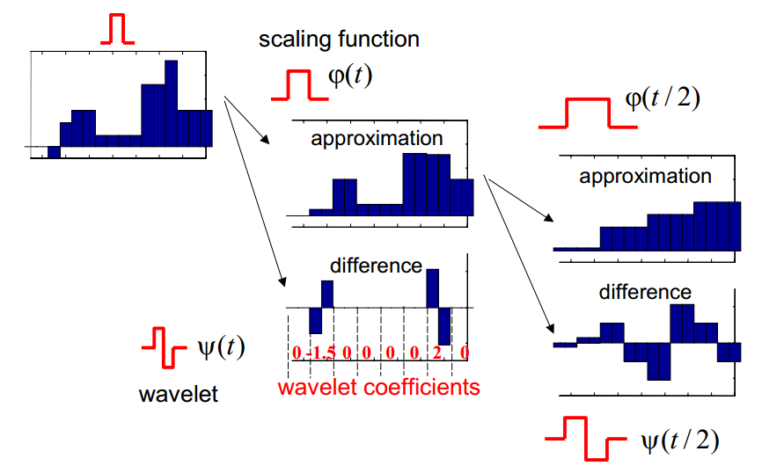
MULTIRESOLUTION ANALYSIS

Slide 21
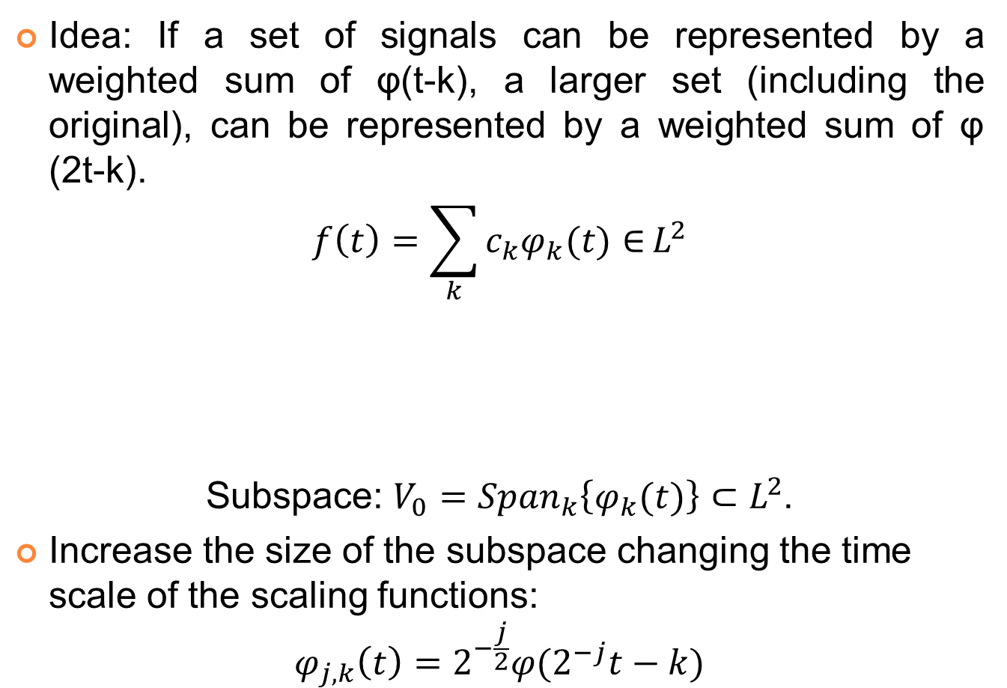
MULTIRESOLUTION ANALYSIS
Idea: If a set of signals can be represented by a weighted sum of φ(t-k), a larger set (including the original), can be represented by a weighted sum of φ (2t-k).
$$f\left(t\right)=\sum_{k}{c_{k}φ_{k}(t)∈}L^{2}$$
Subspace: $V_{0}={Span}_{k}\left\{φ_{k}(t)\right\}⊂L^{2}$.
Increase the size of the subspace changing the time scale of the scaling functions:
$$φ_{j,k}\left(t\right)=2^{−\frac{j}{2}}φ(2^{−j}t−k)$$
Real-valued expansion coefficients
Real-valued expansion functions

Slide 22
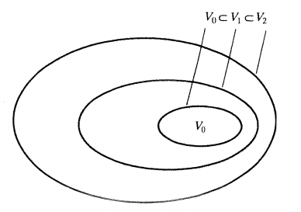

MULTIRESOLUTION ANALYSIS
The spanned spaces are nested:
$$V_{j}=Span\left\{φ_{k}(2^{j}t)\right\}=Span\left\{φ_{j,k}(t)\right\}∈L^{2}$$
$$V_{−∞}⊂…⊂V_{−1}⊂V_{0}⊂V_{1}⊂V_{2}⊂…{⊂V}_{+∞}$$
Wavelets span the differences between spaces w_{i}.
Wavelets and scaling functions should be orthogonal: simple calculation of coefficients.
Nested function spaces spanned by a scaling function

Slide 23
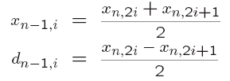
Haar Wavelet Transform - Example
Suppose we are given the following input sequence.
{x_{n,i}} = {10, 13, 25, 26, 29, 21, 7, 15}
Consider the transform that replaces the original sequence with its pairwise average x_{n−1,i} and difference d_{n−1,i} defined as follows:

Slide 24

Haar Wavelet Transform - Example
{10, 13, 25, 26, 29, 21, 7, 15}
$\frac{10+13}{2}$=11.5
10 | 13 | 25 | 26 | 29 | 21 | 7 | 15
11.5 | 25.5 | 25 | 11 | -1.5 | -0.5 | 4 | -4
18.5 | 18 | -7 | 7 | -1.5 | -0.5 | 4 | -4
18.25 | 0.25 | -7 | 7 | -1.5 | -0.5 | 4 | -4

Slide 25
Haar Wavelet Transform - Example
The averages and differences are applied only on consecutive pairs of input sequences whose first element has an even index.
The number of elements in each set {x_{n−1,i}} and {d_{n−1,i}} is exactly half of the number of elements in the original sequence.
Form a new sequence having length equal to that of the original sequence by concatenating the two sequences {x_{n−1,i} } and {d_{n−1,i}}. The resulting sequence is
{x_{n,i}, d_{n-1,i}} = {11.5, 25.5, 25, 11, −1.5, −0.5, 4, −4}

Slide 26
Haar Wavelet Transform - Example
This sequence has exactly the same number of elements as the input sequence - the transform did not increase the amount of data.
Since the first half of the above sequence contain averages from the original sequence, we can view it as a coarser approximation to the original signal.
The second half of this sequence can be viewed as the details or approximation errors of the first half.

Slide 27


Haar Wavelet Transform - Example
Synthesis: The original sequence can be reconstructed from the transformed sequence using the relations
Analysis (Haar wavelet transform)

Slide 28
Haar Wavelet Transform - Example
10 | 13 | 25 | 26 | 29 | 21 | 7 | 15
11.5 | 25.5 | 25 | 11 | -1.5 | -0.5 | 4 | -4
18.5 | 18 | -7 | 7 | -1.5 | -0.5 | 4 | -4
18.25 | 0.25 | -7 | 7 | -1.5 | -0.5 | 4 | -4
{18.25, 0.25, -7, 7, -1.5, -0.5, 4, 4}

Slide 29
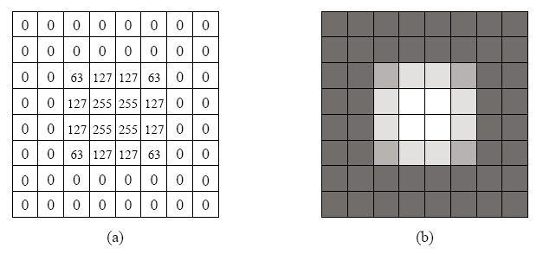
Haar Wavelet Transform - Example
Input image for the 2D Haar Wavelet Transform.
(a) The pixel values. (b) Shown as an 8×8 image.

Slide 30
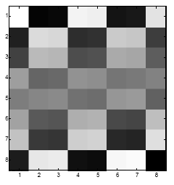
Haar Wavelet Transform - Example
33 | 32 | 33 | 32 | 31 | -29 | 27 | -25
32.5 | 32.5 | 0.5 | 0.5 | 31 | -29 | 27 | -25
32.5 | 0 | 0.5 | 0.5 | 31 | -29 | 27 | -25

Slide 31
Haar Wavelet Transform - Example
Appling on rows
detail coefficients
row average

Slide 32
Haar Wavelet Transform - Example
Appling on columns

Slide 33
Haar Wavelet Transform - Example
Appling on columns
Choose a threshold δ
δ = 5

Slide 34
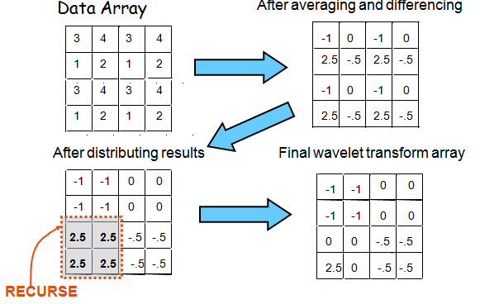
Example Decomposition Of a 4×4 Array

Slide 35
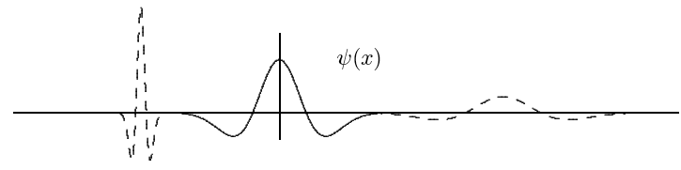

CONTINUOUS WAVELET TRANSFORM
Width of the window is changed as the transform is computed for every spectral components.
$$W_{x;ψ}\left(τ,s\right)=\frac{1}{\sqrt{\left|s\right|}}\int_{−∞}^{∞}{f(t)∙ψ^{∗}\left(\frac{t−τ}{s}\right)}dt$$
$τ$: translation (the location of the window)
$s$: scale
$ψ^{∗}$: mother wavelet
$∗$ denotes complex conjugation

Slide 36
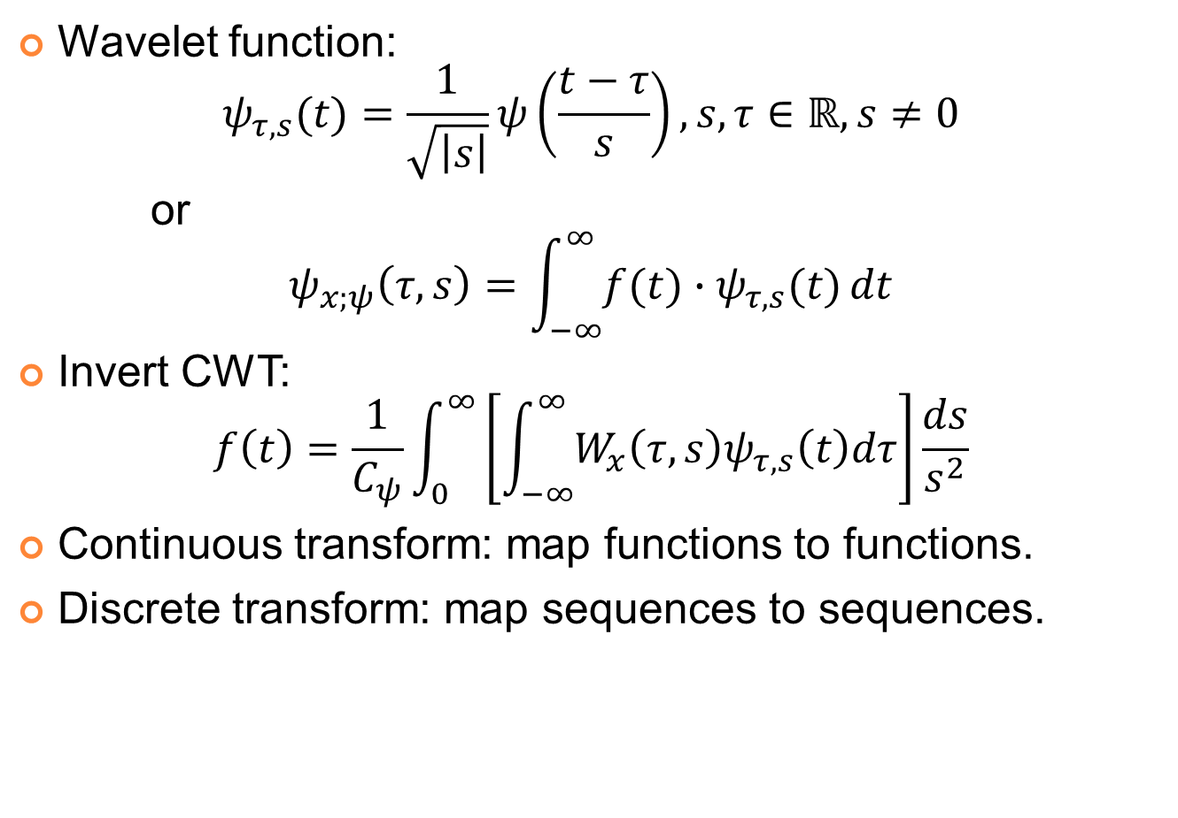
CONTINUOUS WAVELET TRANSFORM
Wavelet function:
$$ψ_{τ,s}(t)=\frac{1}{\sqrt{\left|s\right|}}ψ\left(\frac{t−τ}{s}\right), s,τ∈ℝ,s≠0$$
or
$$ψ_{x;ψ}\left(τ,s\right)=\int_{−∞}^{∞}{f(t)∙ψ_{τ,s}(t)}dt$$
Invert CWT:
$$f\left(t\right)=\frac{1}{C_{ψ}}\int_{0}^{∞}{\left[\int_{−∞}^{∞}{W_{x}\left(τ,s\right)ψ_{τ,s}\left(t\right)dτ}\right]}\frac{ds}{s^{2}}$$
Continuous transform: map functions to functions.
Discrete transform: map sequences to sequences.

Slide 37
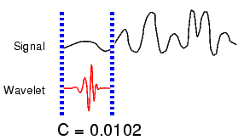
CONTINUOUS WAVELET TRANSFORM
Five Easy Steps to a Continuous Wavelet Transform
Take a wavelet and compare it to a section at the start of the original signal.
Calculate a correlation coefficient c

Slide 38
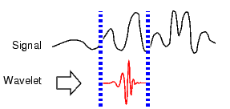
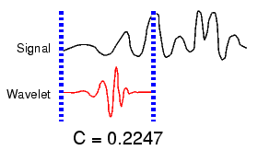
CONTINUOUS WAVELET TRANSFORM
Five Easy Steps to a Continuous Wavelet Transform
Shift the wavelet to the right and repeat steps 1 and 2 until you've covered the whole signal.
Scale (stretch) the wavelet and repeat steps 1 through 3.
Repeat steps 1 through 4 for all scales

Slide 39
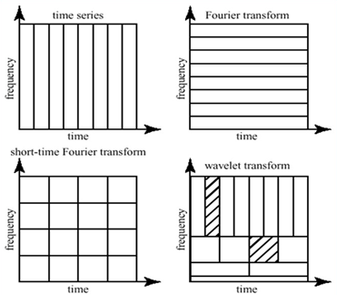
Fourier vs. Wavelet
Fourier vs Wavelet transform
From http://www.cerm.unifi.it/EUcourse2001/Gunther_lecturenotes.pdf, p.10
Notes:
FFT, basis functions: sinusoids
Wavelet transforms: small waves, called wavelet
FFT can only offer frequency information
Wavelet: frequency + temporal information
Fourier analysis doesn’t work well on discontinuous, “bursty” data: music, video, power, earthquakes,…

Slide 40
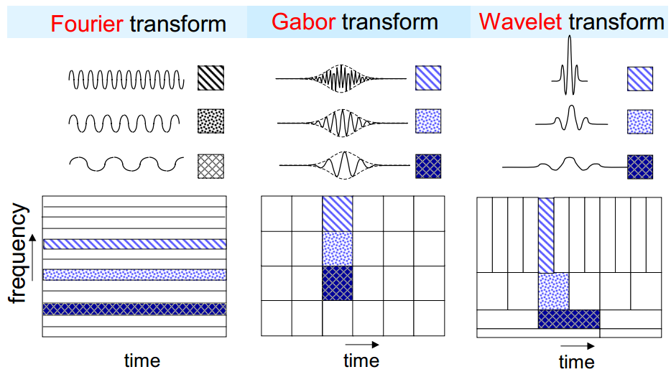
Fourier vs. Wavelet
Notes:
FFT, basis functions: sinusoids
Wavelet transforms: small waves, called wavelet
FFT can only offer frequency information
Wavelet: frequency + temporal information
Fourier analysis doesn’t work well on discontinuous, “bursty” data: music, video, power, earthquakes,…

Slide 41
Fourier vs. Wavelet
Fourier
Loses time (location) coordinate completely
Analyses the whole signal
Short pieces lose “frequency” meaning
Wavelets
Localized time-frequency analysis
Short signal pieces also have significance
Scale = Frequency band

Slide 42
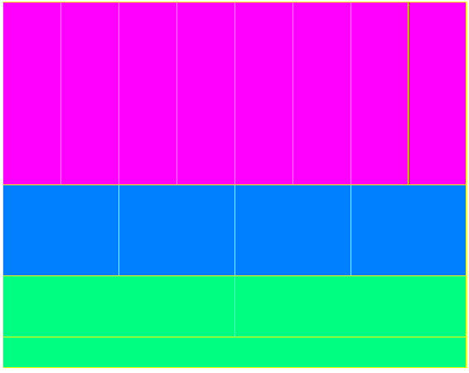
CONTINUOUS WAVELET TRANSFORM
Better time resolution;
Poor frequency resolution
Frequency
Better frequency resolution;
Poor time resolution
Time
Each box represents a equal portion
Resolution in STFT is selected once for entire analysis

Slide 43
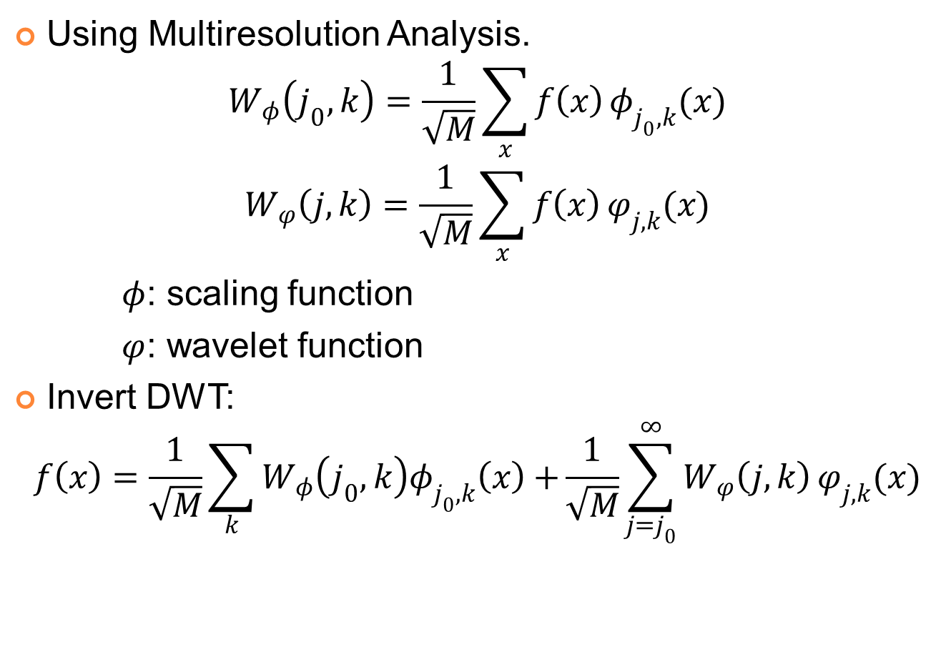
DISCREET WAVELET TRANSFORM
Using Multiresolution Analysis.
$$W_{φ}\left(j_{0},k\right)=\frac{1}{\sqrt{M}}\sum_{x}{f\left(x\right)}φ_{j_{0},k}(x)$$
$$W_{φ}\left(j,k\right)=\frac{1}{\sqrt{M}}\sum_{x}{f\left(x\right)}φ_{j,k}(x)$$
$φ$: scaling function
$φ$: wavelet function
Invert DWT:
$$f\left(x\right)=\frac{1}{\sqrt{M}}\sum_{k}{W_{φ}\left(j_{0},k\right)φ_{j_{0},k}\left(x\right)+}\frac{1}{\sqrt{M}}\sum_{j=j_{0}}^{∞}{W_{φ}\left(j,k\right)}φ_{j,k}(x)$$

Slide 44
DISCREET WAVELET TRANSFORM
In the discrete signal case we compute the Discrete Wavelet Transform by successive low pass and high pass filtering of the discrete time-domain signal. This is called the Mallat algorithm or Mallat-tree decomposition.
Unfortunately, if we actually perform this operation on a real digital signal, we wind up with twice as much data as we started with. Suppose, for instance, that the original signal S consists of 1000 samples of data. Then the approximation and the detail will each have 1000 samples, for a total of 2000.
To correct this problem, we introduce the notion of downsampling. This simply means throwing away every second data point.

Slide 45
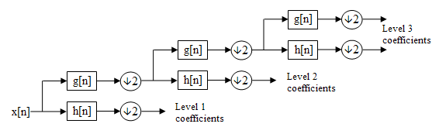
DISCREET WAVELET TRANSFORM
downsampling
DWT filter bank
g[n]: lowpass filter, scaling function
h[n]: highpass filter, wavelet function

Slide 46
Pyramidal Wavelet Decomposition

Slide 47
DISCREET WAVELET TRANSFORM
Wavelet transforms
Low pass filtering: averaging
High pass filtering: differencing
Input data: a, b
Average: s = (a + b) / 2 (low pass filtering)
Difference: d = a – s (high pass filtering)
Wavelet coefficients: (s, d).
Inverse wavelet transforms: addition; subtraction
Wavelet coefficients: (s, d).
Addition: s + d = s + (a – s) = a,
Subtraction: s – d = s – (a – s) = 2s – a = b
Input data: (a, b).

Slide 48
DISCREET WAVELET TRANSFORM
Example: input data 14, 22
Wavelet Transform
Average: s = (14＋22)/2 = 18,
Difference: d = 14-18= -4
Wavelet coefficients: (18, -4).
Inverse Wavelet Transform (to recover the input data)
s ＋ d = 18+(-4) = 14,
s － d = 18-(-4) = 22
Input data: (14, 22).

Slide 49
DISCREET WAVELET TRANSFORM
Compression algorithms using DWT
Embedded zero-tree (EZW)
Use DWT for the decomposition of an image at each level.
Scans wavelet coefficients subband by subband in a zigzag manner.
Set partitioning in hierarchical trees (SPHIT)
Highly refined version of EZW.
Perform better at higher compression ratio for a wide variety of images than EZW.
Zero-tree entropy (ZTE)
Quantized wavelet coefficients into wavelet trees to reduce the number of bits required to represent those trees.
Quantization is explicit instead of implicit, make it possible to adjust the quantization according to where the transform coefficient lies and what it represents in the frame.
Coefficient scanning, tree growing, and coding are done in one pass.
Coefficient scanning is a depth first traversal of each tree.

Slide 50
CWT vs. DWT
 | CWT | DWT
1. Scale | At any scale | Dyadic scales
2. Translation | At any point | Integer point
3. Wavelet | Any wavelet that satisfies minimum criteria | Orthogonal, biorthogonal, …
4. Computation | Large | Small
5. Detection | Easily detects direction, orientation | Cannot detect minute object if not finely tuned
6. Application | Pattern Recognition Feature extraction Detection | Compression De-noising Transmission Characterization

Slide 51
FAST WAVELET TRANSFORM
Basic idea of Fast Wavelet Transform
(Mallat’s herringbone algorithm):
Pyramid algorithm provides an efficient calculation.
DWT (direct and inverse) can be thought of as a filtering process.
After filtering, half of the samples can be eliminated: subsample the signal by two.
Subsampling: Scale is doubled.
Filtering: Resolution is halved.

Slide 52
FAST WAVELET TRANSFORM
Decomposition:

Slide 53
FAST WAVELET TRANSFORM
Decomposition:

Slide 54
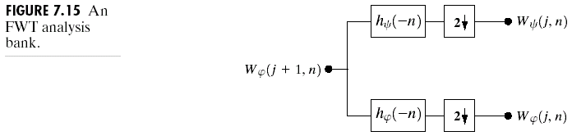
FAST WAVELET TRANSFORM
Decomposition:

Slide 55
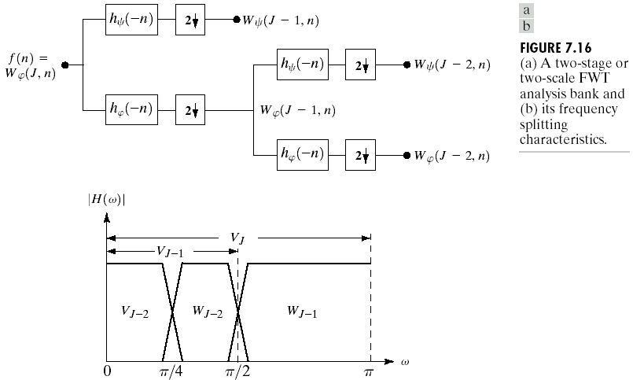
FAST WAVELET TRANSFORM
Decomposition:

Slide 56
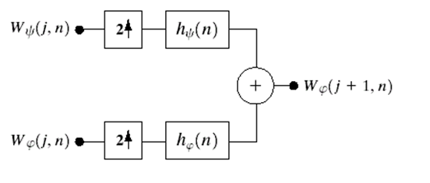

FAST WAVELET TRANSFORM
Synthesis

Slide 57
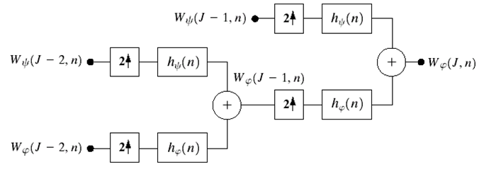

FAST WAVELET TRANSFORM
Synthesis

Slide 58
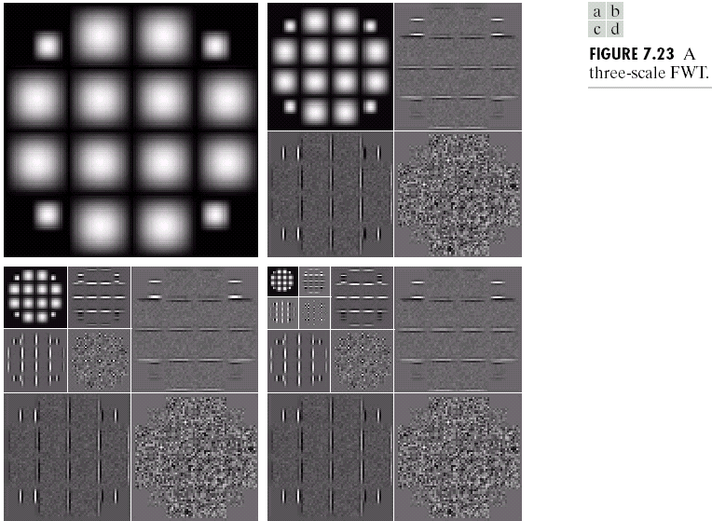
FAST WAVELET TRANSFORM

Slide 59
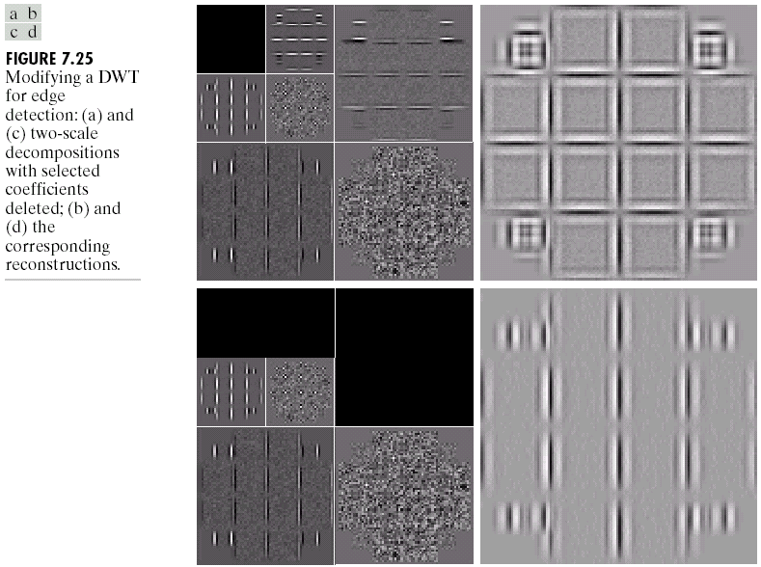
FAST WAVELET TRANSFORM

Slide 60
LIFTING SCHEME
The lifting scheme is an alternative method of computing the wavelet coefficients.
Advantages of the lifting scheme:
Requires less computation and less memory.
Linear, nonlinear, and adaptive wavelet transform is feasible, and the resulting transform is invertible and reversible.

Slide 61
LIFTING SCHEME
A spatial domain construction of bi-orthogonal wavelets, consists of the 4 operations:
Split : s_{k}⁽⁰⁾=x_{2i}⁽⁰⁾, d_{k}⁽⁰⁾=x_{2i+1}⁽⁰⁾
Predict : d_{k}^{(r)}= d_{k}^{(r-1)} – ∑p_{j}^{(r)} s_{k+j}^{(r-1)}
Update : s_{k}(r)= s_{k}^{(r-1)} + ∑u_{j}^{(r)} d_{k+j}^{(r)}
Scaling : s_{k}^{(R)}=K₀s_{k}^{(R)}, d_{k}^{(R)}=K₁d_{k}^{(R)}

Slide 62
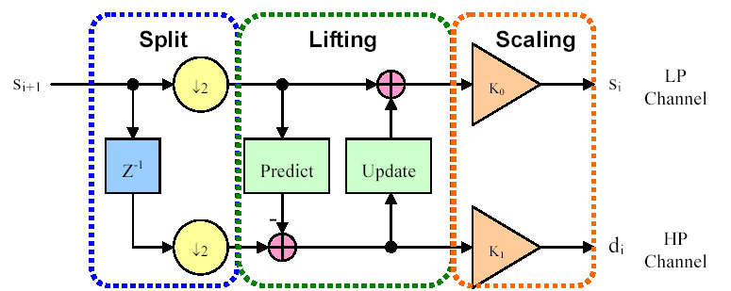
LIFTING SCHEME
A spatial domain construction of bi-orthogonal wavelets, consists of the 4 operations:

Slide 63
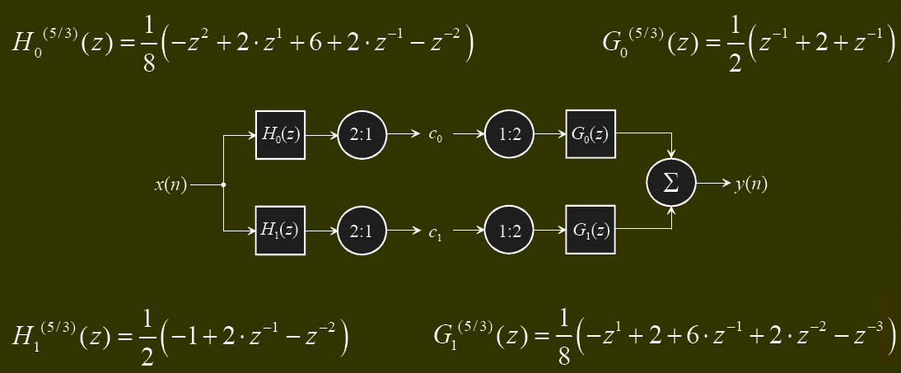
LIFTING SCHEME
Example: Conventional 5/3 filter
C₀ = (4*x[0]+2*x[0]+2*(x[-1]+x[1])-(x[2]+x[-2]) )/8
C₁ = x[0]- (x[1]+x[-1])/2
Number of operations per pixel = 9+3 = 12

Slide 64
WAVELET PACKET
In the usual dyadic wavelet decomposition (transform), only the low-pass filtered subband is recursively decomposed and thus can be represented by a logarithmic tree structure.
A wavelet packet decomposition allows the decomposition to be represented by any pruned subtree of the full tree topology.
The wavelet packet decomposition is very flexible.

Slide 65
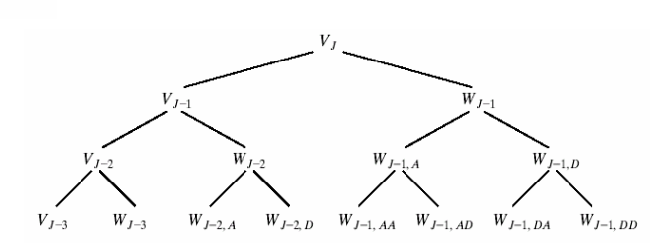
WAVELET PACKET
The cost of this generalization is an image in computational complexity from O(M) for FWT to O(M log M).
A three-scale wavelet packet analysis tree

Slide 66
Applied Fields Using Wavelets
Astronomy
Acoustics
Nuclear engineering
Sub-band coding
Signal and Image processing
Neurophysiology
Music
Magnetic resonance imaging
Speech discrimination
Optics
Fractals
Turbulence
Earthquake-prediction
Radar
Human vision
Pure mathematics applications such as solving partial differential equations

Slide 67
WAVELET TRANSFORM APPLICATION
Compress image: JPEG 2000
Compress video
Compress speech/audio
Store digital Fingerprints
Fingerprints authentication
Reduce noise
Edge detection
…

Slide 68
WAVELET TRANSFORM APPLICATION
Computer and Human Vision
Goal: Artificial vision for robots
Marr Wavelet:intensity changes at different scales in an image.
Image processing in the human has hierarchical structure of layers of processing.
FBI Fingerprint Compression
Goal: Compression of 6MB for pair of hands.
Choose the best wavelets.
Truncate coefficients below a threshold.
Sparse coding makes wavelets valuable tool in data compression.

Slide 69
WAVELET TRANSFORM APPLICATION
Denoising Noisy Data
Goal: Recovering a true signal from noisy data.
Wavelet shrinkage and Thresholding methods.
Signal is transformed using Coiflets, thresholded and inverse-transformed.
No smoothing of sharp structures required, one step forward.
Musical Tones
Goal: Sound synthesis.
Notes from instrument decomposed into wavelet packet coefficients.
Reproducing the note requires reloading those coefficients into wavelet packet generator.
Wavelet-packet-based music synthesizer.

Slide 70

JPEG 2000 Encoder Block Diagram
Key Technologies:
Discrete Wavelet Transform (DWT)
Embedded Block Coding with Optimized Truncation (EBCOT)
Notes:
Image compression: Reduce the redundancy of the image data in order to be able to store or transmit data in an efficient form.
For human eyes, the image will still seems to be the same even when the Compression ratio is equal 10
Human eyes are less sensitive to those high frequency signals
Our eyes will average fine details within the small area and record only the overall intensity of the area, which is regarded as a lowpass filter.

Slide 71
Wavelets in Image Coding
Orthogonal vs. Biorthogonal:
JPEG 2000 uses biorthogonal filters
Lossless and lossy compression
Cohen-Daubechies-Feavau filters 9/7
CDF 5/3 for lossless compression (integer)
Filters are symmetric/anti-symmetric
Nearly orthogonal
Symmetric extensions of the input data
Common Wavelet Filters
Haar: simplest, orthogonal, not very good
Daubechies 8/8: orthogonal
Daubechies 9/7: bi-orthogonal, most commonly used if numerical reconstruction errors are acceptable.
LeGall 5/3: bi-orthogonal, integer operation, can be implemented with integer operations only, used for lossless image coding.

Slide 72
Steps in JPEG 2000
Tiling: The image is split into tiles, rectangular regions of the image that are transformed and encoded separately. Tiles can be any size. Dividing the image into tiles is advantageous in that the decoder will need less memory to decode the image and it can opt to decode only selected tiles to achieve a partial decoding of the image. Using many tiles can create a blocking effect.
Wavelet Transform: Either CDF 9/7 or CDF 5/3 biorthogonal wavelet transform.
Quantization: Scalar quantization
Coding: The quantized subbands are split into precincts, rectangular regions in the wavelet domain. They are selected in a way that the coefficients within them across the sub-bands form approximately spatial blocks in the image domain. Precincts are split further into code blocks. Code blocks are located in a single sub-band and have equal sizes. The encoder has to encode the bits of all quantized coefficients of a code block, starting with the most significant bits and progressing to less significant bits by EBCOT scheme.
Notes:
EBCOT: embedded block coding with optimized truncation

Slide 73
DWT in JPEG 2000
Step 1:
A | B | C | D |  | A+B | C+D | A-B | C-D
 |  |  |  |  | L |  | H
20 | 15 | 30 | 20 |  | 35 | 50 | 5 | 10
17 | 16 | 31 | 22 |  | 33 | 53 | 1 | 9
15 | 18 | 17 | 25 |  | 33 | 42 | -3 | -8
21 | 22 | 19 | 18 |  | 43 | 37 | -1 | 1
Original image O
1st horizontal separation

Slide 74
DWT in JPEG 2000
Step 2:
A |  | C |  |  | A+B |  | C+D
B |  | D |  |  | LL |  | HL
L |  | H |  |  | A-B |  | C-D
 |  |  |  |  | LH |  | HH
35 | 50 | 5 | 10 |  | 68 | 103 | 6 | 19
33 | 53 | 1 | 9 |  | 76 | 79 | -4 | -7
33 | 42 | -3 | -8 |  | 2 | -3 | 4 | 1
43 | 37 | -1 | 1 |  | -10 | 5 | -2 | -9
1st horizontal separation
1st vertical separation

Slide 75
DWT in JPEG 2000
LL1 | HL1 |  | LL2 | HL2 | HL1
 |  |  | LH2 | HH2
LH1 | HH1 |  | LH1 |  | HH1
First level
Second level
LL3 | HL3 | HL2 | HL1
LH3 | HH3
LH2 |  | HH2
LH1 |  |  | HH1
Most important part of the image
Third level

Slide 76
DWT in JPEG 2000
LL3 | HL3 | HL2 | HL1
LH3 | HH3
LH2 |  | HH2
LH1 |  |  | HH1
68 | 103 | 6 | 19 |  | 326 | -38 | 6 | 19
76 | 79 | -4 | -7 |  | 16 | -32 | 2 | -7
2 | -3 | 4 | 1 |  | 2 | -3 | 4 | 1
-10 | 5 | -2 | -9 |  | -10 | 5 | -2 | -9
1st vertical separation
2nd level DWT result

Slide 77

DWT in JPEG 2000

Slide 78

DWT in JPEG 2000

Slide 79



JPEG2000 vs JPEG

Slide 80
EZW ALGORITHM
The EZW (Embedded Zero tree Wavelet) algorithm was one of the first algorithms to show the full power of wavelet-based image compression.
The embedding process used by EZW is called bit-plane encoding.
Step 1 (Initialize). Choose initial threshold, T = T₀, such that all transform values satisfy |w(m)| < T₀ and at least one transform value satisfies |w(m)| ≥T₀/2.
Step 2 (Update threshold). Let T_{k} = T_{k−1}/2.

Slide 81
EZW ALGORITHM
Step 3 (Significance pass). Scan through insignificant values using baseline algorithm scan order. Test each value w(m) as follows:
If |w(m)| ≥ T_{k}, then
Output sign of w(m)
Set w_{Q}(m) = T_{k}
Else if |w(m)| < T_{k} then
Let w_{Q}(m) retain its initial value of 0.

Slide 82
EZW ALGORITHM
Step 4 (Refinement pass ). Scan through significant values found with higher threshold values T_{j} , for j < k (if k = 1 skip this step). For each significant value w(m), do the following:
If |w(m)| ∈ [w_{Q}(m), w_{Q}(m) + T_{k}), then
Output bit 0
Else if |w(m)| ∈ [w_{Q}(m) + T_{k}, w_{Q}(m) + 2T_{k}), then
Output bit 1
Replace value of w_{Q}(m) by w_{Q}(m) + T_{k}
Step 5 (Loop). Repeat steps 2 through 4.

Slide 83
DEMO
Haar wavelet transform
Compress image
Reduce noise
Wavelet transform on depth image
Wavelet transform on RGD-D image

Slide 84
FUTURE WORK
Basic wavelet theory is now in the refinement stage
The refinement stage involves generalizations and extensions of wavelets, such as extending wavelet packet techniques.
Wavelet techniques have not been thoroughly worked out in applications such as practical data analysis where for example, discretely sampled time-series data might need to be analyzed.

Slide 85
REFERENCE
English:
Asim Bhatti, Saeid Nahavandi, Yakov Frayman: “3D depth estimation for visual inspection using wavelet transform modulus maxima”, Comput. Electr. Eng., Vol. 33, August 2006.
M. Sifuzzaman, M.R. Islam, M.Z. Ali: “Application of Wavelet Transform and its Advantages Compared to Fourier Transform”, Vidyasagar University, 2009.
Rafael C. Gonzalez & R. E. Woods: “Digital Image Processing Third Edition”, Prentice Hall, ISBN 978-0131687288, pp. 483-543, 2006.
Richard Szeliski: “Computer Vision: Algorithms and Applications”, Springer, ISBN 978-1848829343, pp. 154-160, 2010.
Vietnamese:
Đỗ Ngọc Anh: “Nén ảnh sử dụng biến đổi wavelet và ứng dụng trong các dịch vụ dữ liệu đa phương tiện di động”, Đại học Bách Khoa Hà Nội, 2006.
Nguyễn Thị Lụa: “Nghiên cứu lý thuyết wavelet trong xử lý tín hiệu”, Đại học Bách Khoa Hà Nội, 2001.
Trần Duy Hưng: “Kỹ thuật xử lý ảnh sử dụng biến đổi Wavelet”.
Website:
http://en.wikipedia.org/wiki/Wavelet_transform
http://www.mathworks.com/help/wavelet/ug/wavelet-packets.html

